Slide 1
Transport Layer

Slide 2
Agenda
Purpose of Transport protocols
User Datagram Protocol
Transmission Control Protocol
Header
Sequence numbers and handshake
Stop and wait
Error recovery
Sliding window protocol
ARQ strategies
Connection Oriented / State machine
Socket (TCP Socket, UDP Socket)
TCP Evolution
SCTP and other transport protocol.
Tasks for Today
References

Slide 3
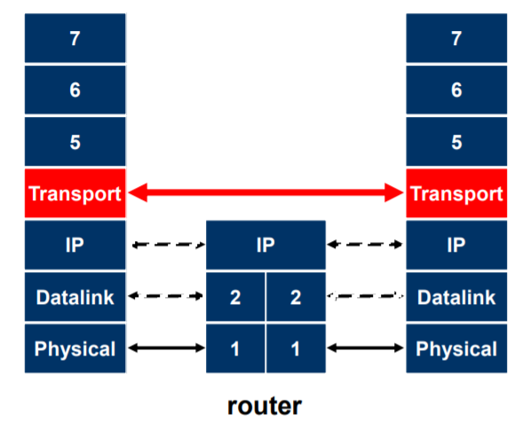
Transport protocols
Network protocols are for best effort delivery only.
Transport layer implement end to end reliable communication.
TCP does multiplexing and demultiplexing using ports.
Headers of the transport layer are treated as payload by L3 devices.
Transport layer implements:
Demultiplexing
Error detection
Error recovery
In-Order delivery
Message boundaries
Connection abstraction
Congestion control.
Among host layers.

Slide 4

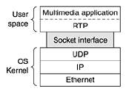
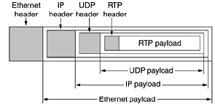
User Datagram Protocol (UDP)
Basic transport level protocol, defined in RFC 768.
Demultiplexes using port number.
Good starting point for protocols implemented at application level.
Examples: DNS, Multiplayer games and multimedia streaming, RTP.
a. RTP working

Slide 5
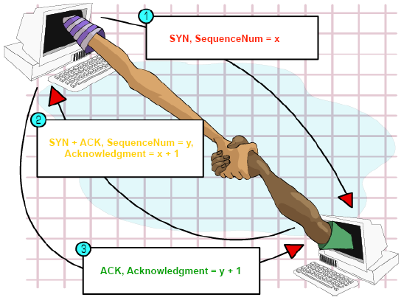
Transmission Control Protocol (TCP)
Provides reliable, ordered and error checked delivery of bytes between applications running on IP network.
TCP is connection oriented protocol.
TCP is ever evolving and still dominantly used for web that is HTTP 1, 2 and 3 standards.
Demultiplexing using ports
Connections using sequence number
Reliability using acknowledgements, checksum
Flow control using window.

Slide 6
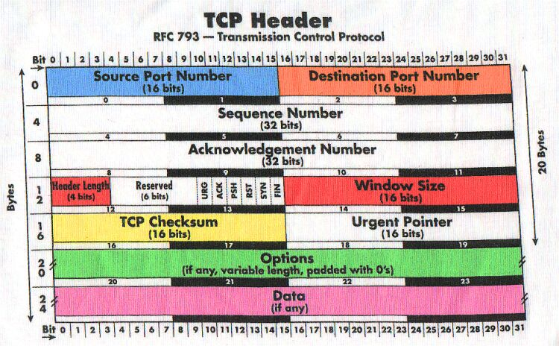

Slide 7
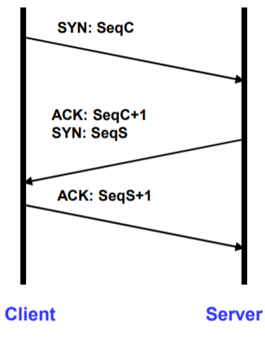
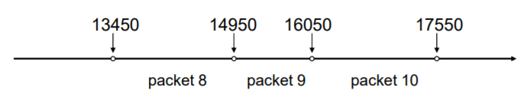
Sequence numbers and handshake
Each byte in byte stream is number with 32 bit value, initial value selected in start up time.
TCP breaks the byte streams into packets limited to Maximum segment size.
Each pack has sequence number indicates where it fits in byte stream.
Each side notifies other with starting sequence number.
Why not simply choose 0s? to avoid overlap with earlier TCP communications.

Slide 8
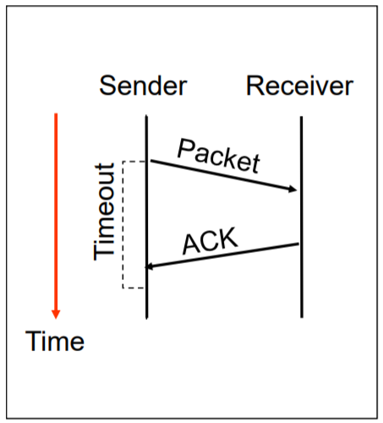
Stop and wait
Send a packet, stop and wait until ACK arrives.
Receiver sends acknowledgement (ACK) when it receives packet.
Sender waits for ACK / timeout.
Simple Automatic repeat request (ARQ) protocol.

Slide 9
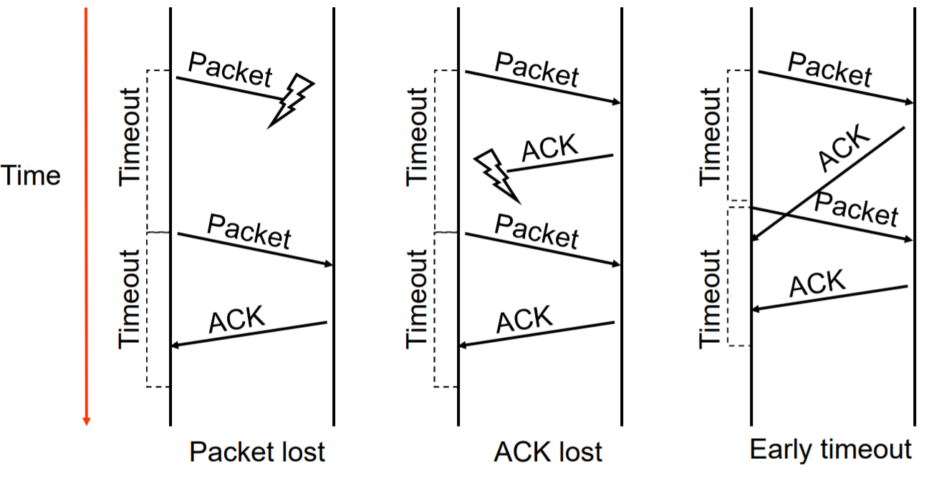
Error recovery

Slide 10
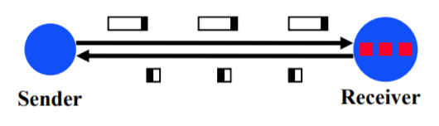
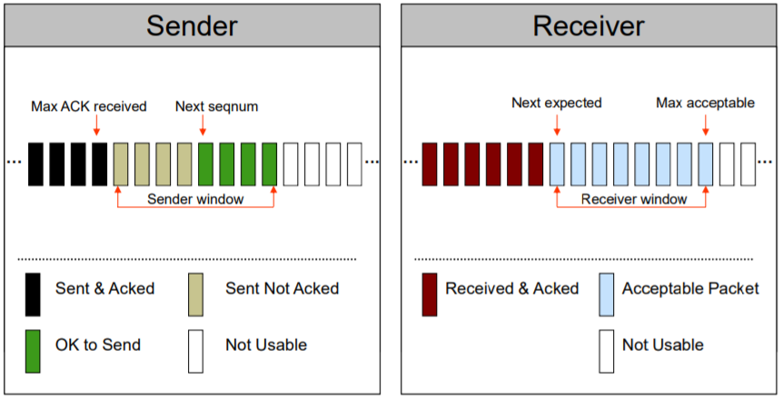
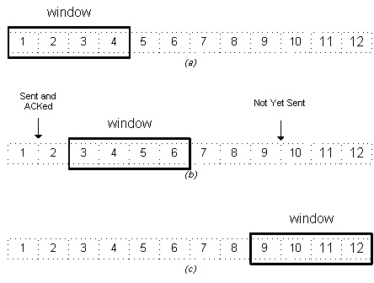
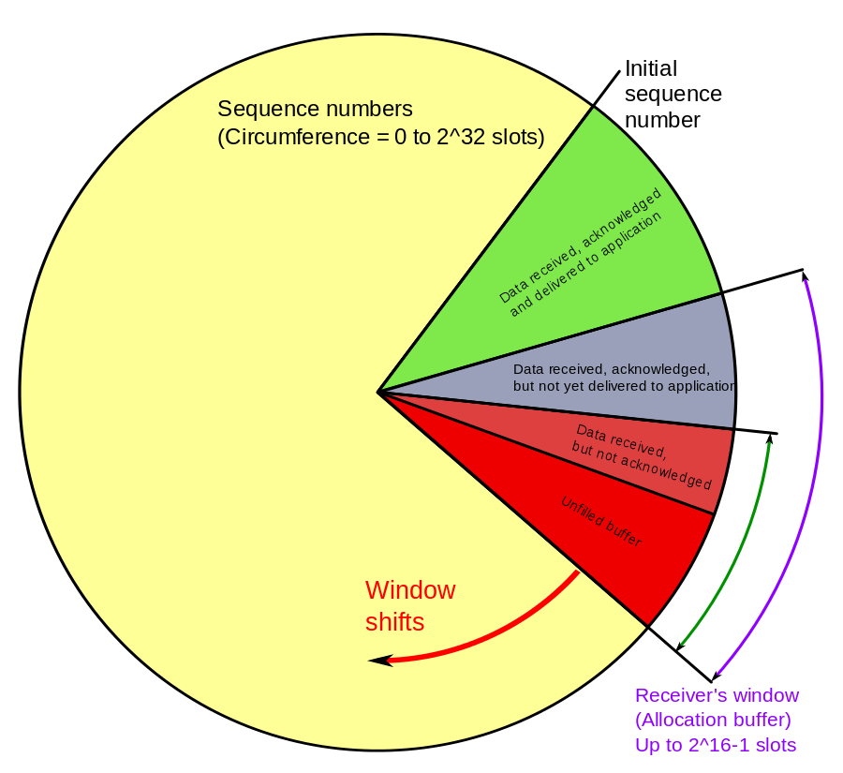
Sliding window protocol
Stop and wait protocol results in poor throughput for long delay paths.
Solution is receiver provides sender with window that can fill will packets.

Slide 11
ARQ strategies
One ACK for every packet is ineffective, cumulative ACKs upto sequence number is simple to implement.
What to do if packets are lost?
Results in gap in sequence of received packets.
Selective repeat retransmission.
Go back N recovery
Selective ACK (SACK)

Slide 12
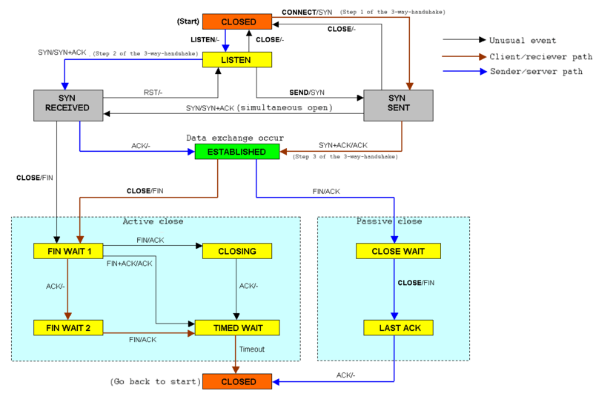
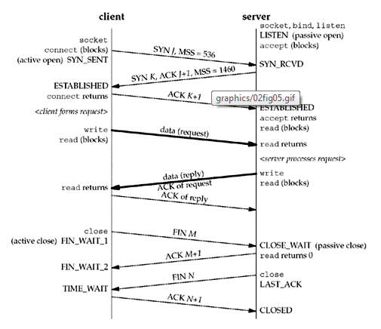
Connection

Slide 13
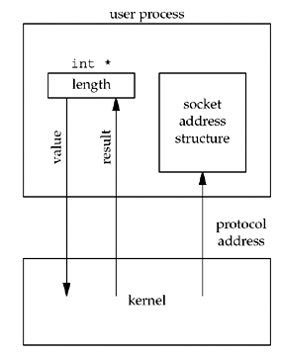
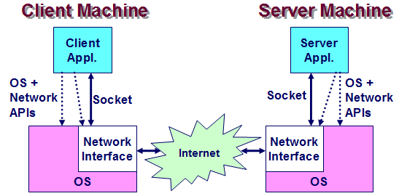

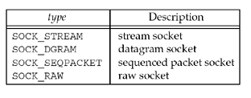
Socket
End point, of a bidirectional inter process communication flow across internet protocol based computer network.
Interface between an application and transport layer.
Combination of IP Address, Port number, protocol.

Slide 14
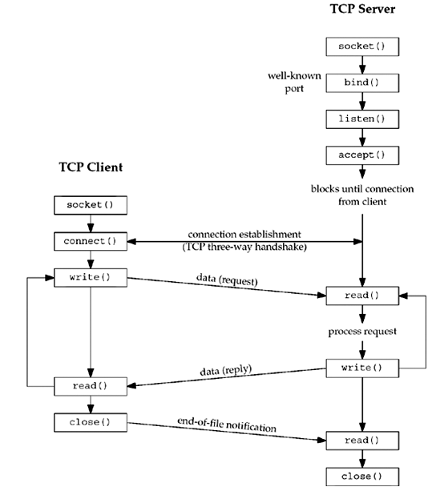
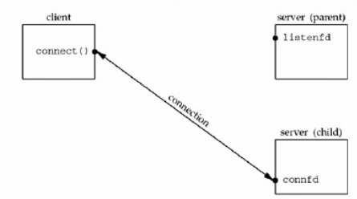
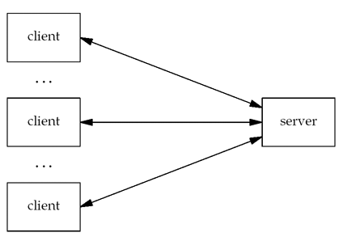
TCP Socket

Slide 15
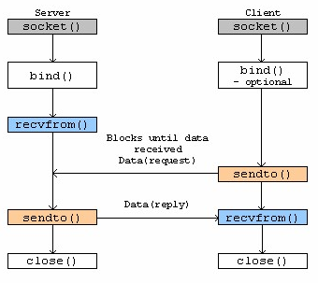
UDP Socket

Slide 16
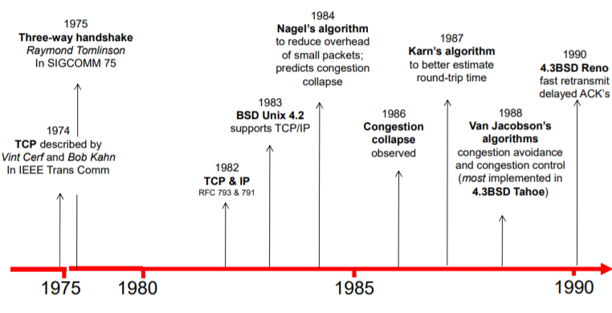
Evolution of TCP

Slide 17
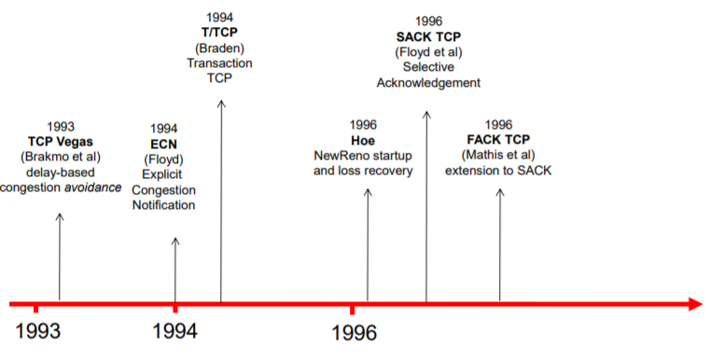
Evolution of TCP

Slide 18
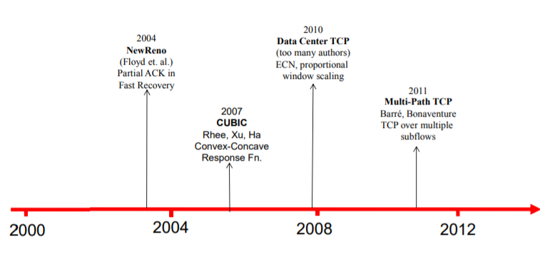
Evolution of TCP

Slide 19
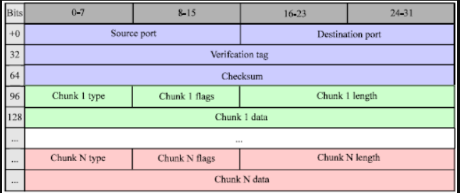
SCTP
Stream control transmission protocol also operates in transport layer serves the role of TCP and UDP. Introduced in year 2000.
Described in RFC 4960.

Slide 20
Tasks for Today
Commands for the day: netstat, and tcpdump
Wireshark packet analyzer
Start recording HTTP traffic, switch window to open a web browser, type http://www.msitprogram.net. Allow the webpage to load completely.
Pauser recording in wireshark.
Observe recorded details of above traffic, view TCP level segment information.
Observe sequence numbers, SYN, FIN and ack packets for this communication. Note: If you follow sequence number you will find all data specific to this traffic.
Observe elements of TCP header and values specific to this communication.
Given following Application layer protocols specify transport protocol for each.
BGP,DHCP,DNS,FTP,HTTP,HTTPS,IMAP,LDAP,MGCP,MQTT,NNTP,NTP,POP,ONC/RPC,RTP,RTSP,RIP,SIP,SMTP,SNMP,SSH,Telnet,TLS/SSL,XMPP
Write TCP & UDP iterative server programs for returning text echo in upper case.
Notes:
Application layer
BGP
DHCP
DNS
FTP
HTTP
HTTPS
IMAP
LDAP
MGCP
MQTT
NNTP
NTP
POP
ONC/RPC
RTP
RTSP
RIP
SIP
SMTP
SNMP
SSH
Telnet
TLS/SSL
XMPP

Slide 21
References
https://en.wikipedia.org/wiki/Transmission_Control_Protocol
https://tools.ietf.org/html/rfc1122
https://en.wikipedia.org/wiki/Multipath_TCP
https://en.wikipedia.org/wiki/User_Datagram_Protocol

Slide 22
Question and Answers (Q&A)
Thank you.

